Slide 1

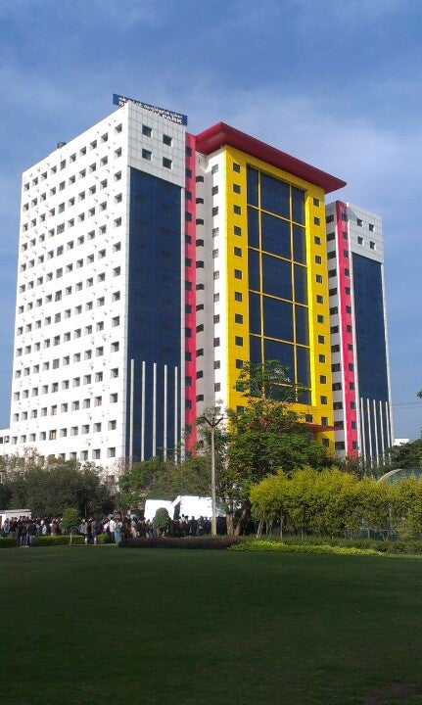
SRM Chatbot: Bridging the Gap Between Students and Faculty
MANASWITA VERMA (RA2111031010068)

Slide 2
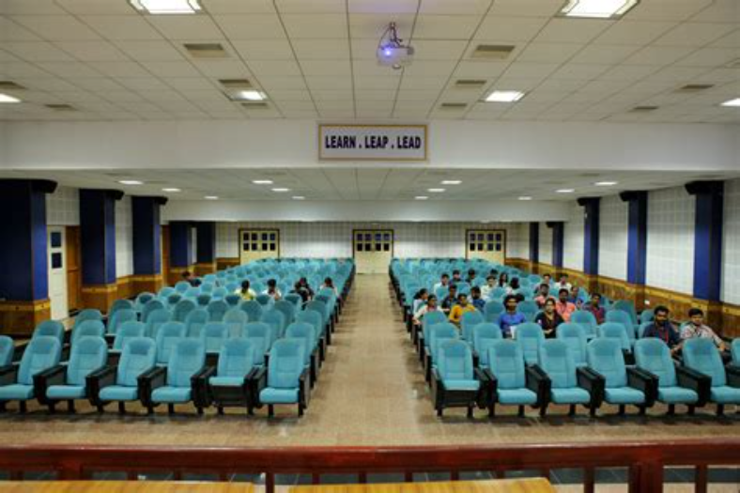
INTRODUCTION
In the dynamic educational landscape of SRM Institute of Science and Technology, fostering effective collaboration between students and faculty members is crucial for nurturing academic excellence and professional development. To address this imperative, the SRM Chatbot has been developed as an innovative platform to seamlessly connect the community. Powered by the machine learning framework TensorFlow, this chatbot leverages advanced natural language processing techniques to efficiently classify user inputs and provide tailored responses to address the diverse needs of students seeking academic support and guidance.

Slide 3

FEATURES
1. Streamlined Search
The SRM Chatbot enables students to quickly identify the most suitable faculty experts for their academic topics of interest. By analyzing the user's query, the chatbot can efficiently match the request to the appropriate faculty member's area of expertise, providing their contact details and office location for seamless communication.
2. Personalized Recommendations
Beyond just identifying experts, the chatbot also allows students to inquire about faculty members' specific interests and preferences for providing support. This enables students to tailor their interactions, whether they need concept clarification, resume reviews, or any other form of academic guidance.
3. Streamlined Connections
By facilitating these connections, the SRM Chatbot serves as a valuable resource for students, empowering them to engage with faculty experts and access the support they need to excel in their academic pursuits.

Slide 4

Harnessing the Power of Machine Learning
Natural Language Understanding
At the core of the SRM Chatbot's capabilities is its natural language understanding (NLU) engine, which leverages advanced machine learning techniques to parse user inputs and extract the underlying intent. By analyzing the context and syntax of user queries, the chatbot can accurately interpret the user's needs and provide relevant responses.
Knowledge Base Integration
The chatbot's knowledge base is meticulously curated, drawing from a wealth of information sources, including FAQs, campus resources, course catalogs, and faculty profiles. This comprehensive data repository enables the chatbot to deliver accurate and informative responses tailored to the user's specific inquiries.
Continuous Learning
To ensure the chatbot's continued relevance and effectiveness, the system is designed to learn and adapt over time. By analyzing user feedback and monitoring interaction patterns, the chatbot can identify areas for improvement and continuously refine its natural language processing and response generation capabilities.

Slide 5

Enhancing the User Experience
Conversational Interface
Accessibility
The SRM Chatbot offers a seamless and intuitive conversational interface, allowing users to interact with the system using natural language, whether through text or voice input. This user-friendly approach ensures a smooth and engaging experience for students, faculty, and staff alike.
The chatbot is designed to be accessible across multiple platforms, including web and mobile, ensuring that users can access its services anytime, anywhere. This flexibility caters to the diverse needs and preferences of the SRM community.
Personalization
Continuous Improvement
By incorporating personalization features, the SRM Chatbot can tailor its responses and recommendations based on individual user profiles and past interactions. This level of customization enhances the user experience and ensures that each interaction is tailored to the specific needs of the individual.
The chatbot's design includes mechanisms for gathering user feedback and analytics, enabling the development team to continuously refine and enhance the system's capabilities. This commitment to improvement ensures that the SRM Chatbot remains a valuable and responsive resource for the community.

Slide 6
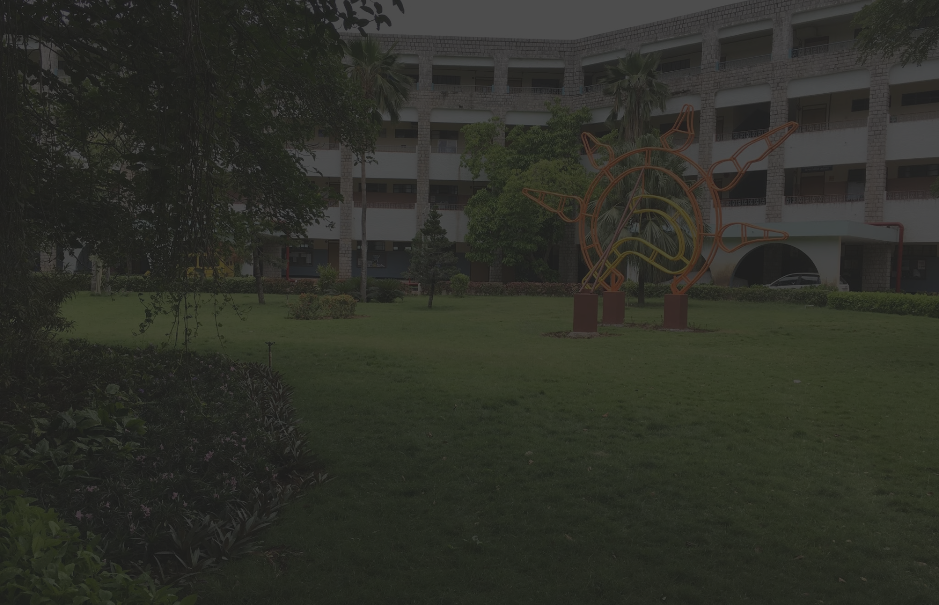
Empowering the SRM Community
Academic Support
Faculty Engagement
Institutional Efficiency
The SRM Chatbot serves as a valuable resource for students, providing them with easy access to faculty experts, course information, and academic support services. This empowers students to take a proactive approach to their learning and development.
By facilitating seamless connections between students and faculty, the chatbot encourages greater engagement and collaboration within the SRM community. This fosters an environment of mutual support and knowledge sharing, ultimately contributing to the institution's academic excellence.
The chatbot's ability to handle a wide range of inquiries and provide timely responses helps to streamline administrative processes and reduce the burden on campus resources. This increased efficiency benefits both students and faculty, allowing them to focus on their core academic and research activities.

Slide 7



Expanding Horizons
Multilingual Support
To cater to the diverse demographics of the SRM community, future enhancements to the chatbot may include the integration of multilingual capabilities, allowing users to interact in their preferred languages.
Intelligent Recommendations
Incorporating advanced machine learning techniques, the chatbot could provide personalized recommendations for courses, events, and campus resources based on individual user preferences and academic goals.

Slide 8
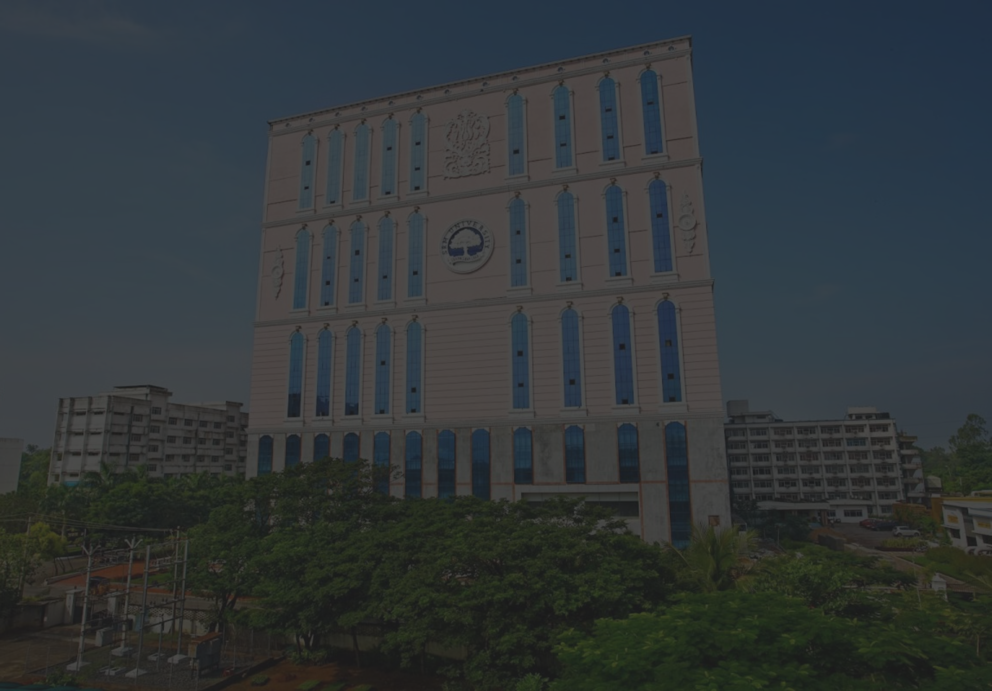
Fostering a Connected Campus
Collaborative Learning
Streamlined Communication
The SRM Chatbot's ability to connect students with faculty experts and campus resources promotes a culture of collaborative learning, where students can actively engage with their professors and peers to deepen their understanding of course material and explore new areas of interest.
By providing a centralized platform for students to access information and seek support, the chatbot helps to streamline communication within the SRM community, ensuring that everyone can easily navigate the campus resources and services available to them.
Fostering Engagement
Continuous Improvement
The chatbot's user-friendly interface and personalized recommendations encourage students to actively engage with the SRM community, fostering a sense of belonging and promoting their overall academic and personal development.
The SRM Chatbot's commitment to continuous improvement, driven by user feedback and data analytics, ensures that the system remains a valuable and responsive resource for the campus community, adapting to their evolving needs and preferences.

Slide 9
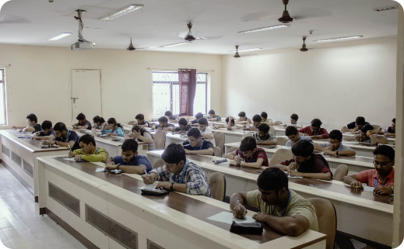
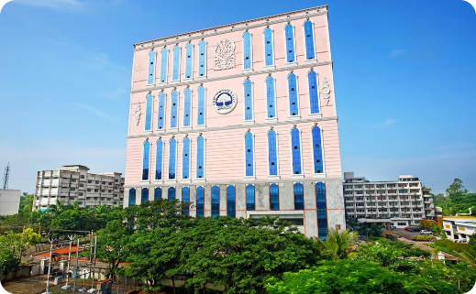
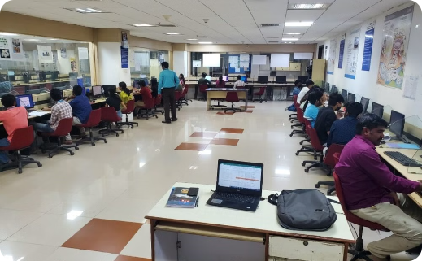
Conclusion:
A Transformative Chatbot
The SRM Chatbot represents a significant step forward in fostering collaboration and engagement within the SRM Institute of Science and Technology community. By seamlessly connecting students with faculty experts and campus resources, the chatbot has become a valuable tool for academic support and professional development. Powered by advanced machine learning and natural language processing techniques, the SRM Chatbot showcases the institution's commitment to embracing innovative technologies and leveraging them to enhance the educational experience for all stakeholders. As the SRM Chatbot continues to evolve and expand its capabilities, it holds the potential to transform the campus experience, empowering students, faculty, and staff to engage more deeply with the institution and unlock new opportunities for growth and success.

